Slide 1
Accident Investigation
A Systematic Approach to Avoiding Workplace Accidents
Safety Leadership Training Series
Our risk control service is advisory only. We assume no responsibility for management or control of customer safety activities nor implementation of recommended corrective measures. The illustrations, instructions and principles contained in the material are general in scope and, to the best of our knowledge, current at the time of publication. No attempt has been made to interpret any referenced codes, standards, or regulations. Please refer to the appropriate code-, standard-, or regulation-making authority for interpretation or clarification. Only your policy or contract can give actual terms, conditions and exclusions.
Notes:
Notes to Instructor/Facilitator
The Safety Leadership Training program is a series of 22 individual safety training modules designed to help managers and supervisors gain knowledge and develop skills to reduce or eliminate losses in your workplace. Each module minimally consists of a PowerPoint presentation with a Discussion Leader’s Guide available in the Notes Section. The SLT program is designed to be flexible and customized to meet your needs. Not all 22 sessions need to be delivered, but when all 22 sessions have been completed, the attendees have completed a substantial development program.
Welcome to “Accident Investigation” The purpose of this series is to provide a general understanding of essential safety topics for managers and supervisors.
This module sets the foundation for your accident investigation program so it is recommended that a senior leader from the organization deliver this session to show commitment to creating and maintaining a work environment that promotes safety while simultaneously supporting production, sales and quality.
Because much of this session discusses information unique to your company, this has been designed to be a generic presentation that you can customize for your organization. To prepare to deliver this training, please review the entire presentation and Discussion Leader’s Notes prior to the session.
______________________________________________________________
Discussion Leader’s Notes:
During this session, we will review accident investigation. Why do we complete accident investigations? Boiled down to fundamentals, the reasons for accident investigation are directly related to your management responsibilities. They are:
To discover all causes of work stoppages, and
To eliminate these causes in order to prevent recurrence.
The purpose of this session is to provide you with knowledge on our expectation for accident investigations and review the accident investigation method.

Slide 2
Do’s
Actively participate by contributing
  Ask questions
  Share experiences
  Request explanations
Be supportive of your co-workers
Apply what you learn to your job
Pass on the information
Notes:
Notes to Instructor/Facilitator
Here are some basic points to set the tone for the meeting. Expand as needed.
____________________________________
Discussion Leader’s Notes:
Here are some guidelines for the way we will conduct this meeting:
DO
Ask a question when you have one.
Feel free to share an illustration or personal experiences.
Request an example if a point is not clear.
Actively participate – there’s no such thing as a silly question, particularly when talking about safety.
Support your co-workers. Be courteous and encouraging as they offer input to this meeting.
Search for ways in which you can apply this general principle or idea to your work environment. Turn this knowledge into know-how.
Pass on information learned here to your subordinates or any co-workers who have not attended this session.

Slide 3
Objectives
As a result of today’s session, you will:
Understand the importance and benefits of completing accident investigation
Learn your role in completing accident investigations
Know the process for completing accident investigations
Notes:
Discussion Leader’s Notes:
It is our goal that after today’s session, you will be able to understand why we complete accident investigations and benefits of accident investigation. We will discuss your role in completing accident investigations. After this session, you should also understand the method for completing accident investigations.

Slide 4
Agenda
Benefits of accident investigation
Completing investigations
Determining root causes
Integrated solutions
Form completion
Notes:
Discussion Leader’s Notes:
In this session, we will have the opportunity to:
Recognize the importance and benefits of prompt and thorough accident investigations.
Review the accident investigation process
Determine true root causes of the accidents, not just apparent direct causes.
Develop integrated solutions and control plans that have maximum effectiveness in preventing recurrence.
Report all relevant facts on an accident report form.

Slide 5
Benefits of Accident Investigation
Prevents similar accidents
Reduces direct & indirect accident costs
Identifies problems
Improves methods, conditions and production
Reveals training needs
Shows management concern
Adds to your knowledge of operations
Notes:
Notes to Instructor/Facilitator
Ask the group to give examples of the values of accident investigations.
____________________________________
Discussion Leader’s Notes:
One of the key concepts of accident investigation is taking time to look at the operation. There are few times when you get the chance to step back from the day to day grind of the operation and look at the systems of the workplace from a critical perspective. Accident investigation is one of those few opportunities.
Knowledge gained can help prevent occurrences of similar accidents;
Pinpoints the problem areas and helps eliminate production or service breakdowns by improvement in methods and conditions;
Reveals a lack of training or need for retraining;
Often, investigations can identify motivations for employees to perform tasks unsafely.
Boosts morale by demonstrating your concern and top management’s concern;
Adds to your knowledge of the operations in your department; and
Can help reduce Direct and Indirect Accident Costs.
Look at it from a personal viewpoint. We all know that when an accident happens in our department, we lose some of the confidence of top management and employees. A productive accident investigation that broadens your knowledge of your operations and employees can help restore that lost confidence.
All accidents, no matter how small, should be investigated to some degree or another. More serious accidents, or those that cause personal injuries, interrupted operations, or property damage, should be more extensively. Let’s now discuss the when, where, who and how.

Slide 6
When Do You Investigate?
Conditions change
Stories can change
Information is lost
Notes:
Notes to Instructor/Facilitator:
Ask the group when they think you should investigate accidents.
Answers may include “after injured employee is taken care of,” and “when the conditions are made safe.” These are fine, but we must emphasize that investigations take place as soon as possible
Then ask why they think it is important to conduct accident investigations as soon as possible.
____________________________________
Discussion Leader’s Notes:
When should we investigate an accident? It is important to begin the investigation as soon as possible:
While all of the physical conditions are unchanged and employees involved are still available;
While facts are fresh in participants’ minds;
Before memories become distorted;
Before witnesses can have a chance to talk and influence each other; and
Before excuses or second thoughts come into play.
Take care, however, not to question an obviously upset individual who has just sustained and injury or emotional shock. Wait until the individual calms down or the doctor or nurse indicated he/she is ready to discuss the case rationally.
Realistically, there will be occasions when more pressing management problems may demand the supervisor’s immediate attention for a short time. But the supervisor should get back to the accident investigation as promptly as possible and give it full attention.

Slide 7
Who Should Investigate?
Supervisor
Management
Safety Director/EHS
Safety Committee
Notes:
Notes to Instructor/Facilitator:
Ask the group who they think you should investigate accidents.
____________________________________
Discussion Leader’s Notes:
Supervisors should be the point person on accident investigations. Do not delegate or assign this responsibility to anyone else – investigate the accident personally.
The accident occurred in your department and you are in the best position to find out what happened and make immediate changes.
You should want to know what happened and why, so you can prevent a recurrence. Your interest at this time shows your concern for the safety of your employees.
Other individuals (Managers, Safety Director, Safety Committee, etc.) may also have responsibilities in the investigation process, but the supervisor should always play the prominent role.

Slide 8
Other Interested Personnel?
Maintenance
Engineering
Medical
Witnesses
Outside sources
Notes:
Notes to Instructor/Facilitator:
Ask the group what other individuals may be able to assist you with accident investigation.
____________________________________
Discussion Leader’s Notes:
Besides those who have specific responsibilities, there are other interested parties that you may wish to involve in the process.
Maintenance can provide insight into machine and equipment conditions. They will be familiar with preventive maintenance procedures, and can assist by helping your understanding of how things work;
Engineering, if design is involved in the cause or corrective actions;
Medical personnel, if health hazards exist;
Any witnesses to the incident or conditions leading to the incident should be interviewed. Be careful, these individuals may also be suffering from shock due to the accident. Leave questions open ended, and approach everyone with blame.
Outside personnel (insurance, regulatory agencies, etc.) may be important sources for information regarding the accident.

Slide 9
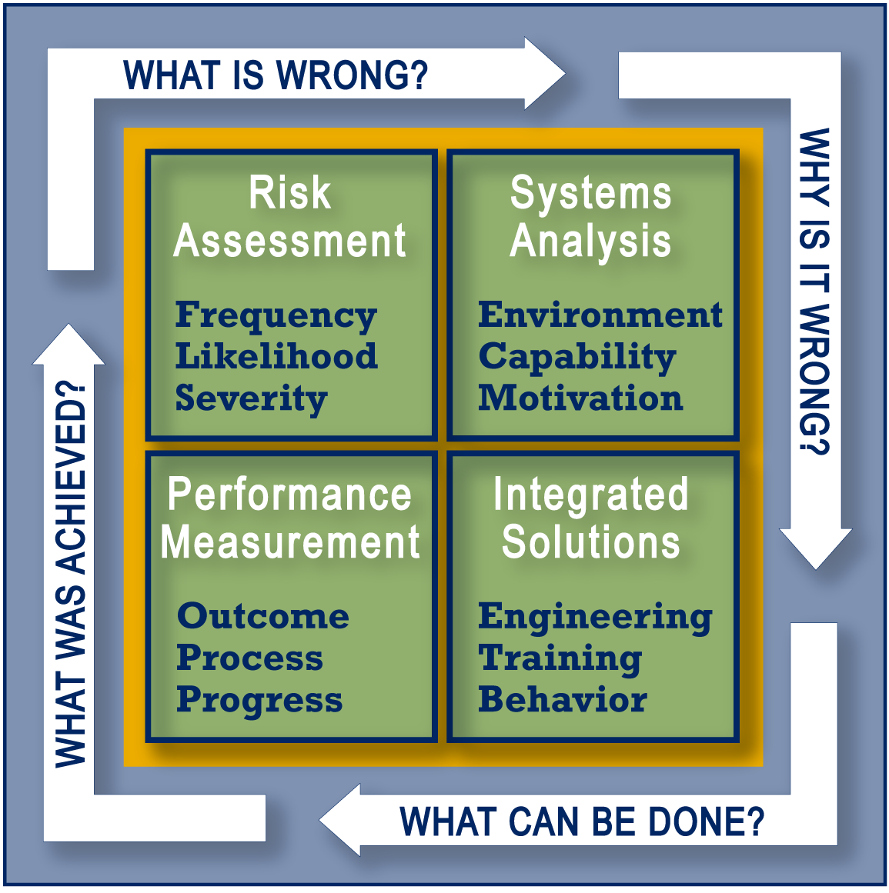
How Do We Investigate?

Slide 10
Fact-gathering
Physical
  What?
  Where?
Person
  Who?
Method/procedures
  How?
Pertinent documentation
Witnesses
Notes:
Discussion Leader’s Notes:
One of the initial steps in the investigation is to gather pertinent facts. It is important to investigate the physical conditions, the persons involved, and the methods/procedures used, and some other factors. The physical conditions surrounding the accident site tell us what and where. The injured person tells us who. The methods they were using at the time of the accident tell us how.
A search and review of pertinent documentation can provide much of the basis for evaluating the what, where, who and how.
Another source of critical undocumented evidence is witnesses.
Let’s look at each of these components more closely.

Slide 11
Physical Conditions
Equipment, machines, materials
Guarding
  Adjusted?
  In place?
Proper machine/tools
Housekeeping/layout/congestion
Materials handled/repetitive motion
Lighting/noise/distractions
Specifics
Notes:
Discussion Leader’s Notes:
You can more easily investigate physical conditions if you think of them in terms of what and where (tools, machines, environment, etc.). Without machines and tools, all production would stop. Yet those same machines and tools can be dangerous unless they are properly guarded, properly used and properly maintained.
What materials were being handled?
Was housekeeping or congestion a possible direct cause?
What adequate lighting available?
What were the floor conditions?
Noise/Distractions?
Where did the accident take place?
BE SPECIFIC

Slide 12
The Person
Experience
Training
Personal habits
Personal conditions (physical, mental, emotional)
Situations at work
Situations away from work
Notes:
Discussion Leader’s Notes:
Gather information about the injured person.
Always approach this part of the investigation with an open mind. Remember the impediments to conducting a solid AI. A normally good employee could just have a bad day, or could be suffering from some situation away from work that causes them to be distracted.

Slide 13
Methods
Are there written procedures?
What critical steps in the procedure are in place to prevent accidents?
Was the correct procedure used?
Timelines involved?
Notes:
Discussion Leader’s Notes:

Slide 14
Witnesses
Who is a witness?
  Direct
  Indirect
How to interview witnesses
  Open ended questions
  Test evidence
  Do not assign blame
How to compile the information
  Oral
  Written
Notes:
Discussion Leader’s Notes:
Witnesses are an important piece of the investigative process. The first, second, or even third hand information you receive can be invaluable.
Who is a witness? Anyone who has knowledge of the incident or knowledge that may be pertinent to the incident. A direct witness is someone who observed the event. An indirect witness is someone who has knowledge of items that contributed to the event such as work habits of the injured employee, characteristics of the piece of equipment that created the damage etc…
How do you interview witnesses? Always begin the interview in a neutral location where the witness will be most at ease. Ask open ended questions… if you ask questions that can be answered with a yes or a no, that is all you will get. Verbally test for evidence, if a person states something that doesn’t seem plausible, ask for an example, or another clarification. Never assign blame during the interview process. It is a normal human inclination to not want to get others in trouble. It is also an impediment to the interviewer if they have the opinion that they already know why the accident occurred and who was at fault.
All information obtained from witnesses should be considered during the investigational process. Further, the information may be discoverable during litigation. Therefore signed witness statements should be obtained whenever possible. If it is not possible to obtain the signed witness statement, the interviewed should confirm back all of the key points that were discussed in the interview and document them. Witnesses are legally able to obtain copies of anything they write and sign, but do not need to be given any other parts of the accident investigation package.

Slide 15
Pertinent Documentation
Work rules
Standard operating procedures
Job safety/hazard analyses
Previous investigations
Safety manual
Internet
Notes:
Notes to Instructor/Facilitator:
Ask the group to give examples of types of documents may be helpful in your investigation.

Slide 16
Root Cause Analysis
Ask “Why” at least 5 times
Don’t accept first impressions
Problem-solve versus assignment of blame
Analyze your systems
What allowed the accident to take place?
Notes:
Discussion Leader’s Notes:
Begin the RCA process by establishing a time-line. You may want to write it out on a piece of paper and then begin to fill in the blanks with the critical events as they occur. This will give you a map to follow as you complete the RCA.
Although 5 times is a random number, by asking why at least this many times you will get closer to the root cause than by relying on settling for the first or most superficial reason.
Also remember that the typical accident has multiple contributing ancillary root causes and may also have several direct causes that led to the accident.

Slide 17
What is a Root Cause?
Underlying system failures
Without the system failure, the accident would not have happened
Accidents typically have more than one root cause
Notes:
Discussion Leader’s Notes:
Underlying System Failures
Without the system failure, the accident would not have happened
Accidents typically have more than one root cause

Slide 18
What is Not a Root Cause?
Immediate or Direct Cause
The cause that most directly led to the accident
  Some examples: broken pallet, human error, failed brakes, etc.
Notes:
Discussion Leader’s Notes:
Immediate or Direct Cause:
The cause that most directly led to the accident
Some Examples: broken pallet, human error, failed brakes, etc.
The direct cause is the proximal event, we want to know what systemic flaws led up to the proximal event.

Slide 19
Accident Causing Discrepancies
Equipment
  People don’t have the tools they need
Skill
  People don’t know what to do
Performance
  People don’t do what they need to do
Engineer
Train
Manage Consequences
Notes:
Discussion Leader’s Guide:
Closing the gaps that cause accidents through engineering, training and managing consequences (behavior management).
Make sure all solutions are integrated with a focus on engineering out the hazard, then training employees why the engineering changes have been made, and finally, managing the employees performance (the outcomes).

Slide 20
Close the Gaps
Notes:
Notes to Instructor/Facilitator:
Ask the group to give examples of where there are system gaps that allow injuries to occur (knowledge, equipment, performance).
Before moving on, ask the following question:
What gap (Equipment, Skill, or Performance do you think results in more injuries?
____________________________________
Discussion Leader’s Notes:
In your investigation, you may find that engineering or process changes need to take place to reduce the risk of a recurrence. Any changes in the engineering or process will undoubtedly result in a need for a change in your training. Even if you do not need a change in engineering or process, training may still be part of the your action plan. Be sure to institutionalize any new training (part of orientation and refresher training), so that it will be provided at the appropriate times in the future.
Any time you change engineering and training, you will want to make sure that employees used the equipment, processes and instruction as intended. The following slide indicates why this is so important.

Slide 21
Heinrich's Third Axiom of Industrial Safety
… For every 330 Unsafe Acts
1
Lost-time or fatal injury
1
Lost-time or fatal injury
29
Minor injuries
29
Minor injuries
300
No injury
300
No injury
Notes:
Discussion Leader’s Notes:
We reduce the serious injuries by reducing the unsafe acts.

Slide 22

Performance Gaps
Why Do We Do What We Do?
Notes:
Discussion Leader’s Notes:
To help understand how to effect behavior, we first have to understand what motivates us to behave certain ways.
We have to understand, “Why we do what we do?”

Slide 23
The ABC’s of Human Behavior
Antecedent (Cues or signals to do something)
Behavior (What we can see someone do)
Consequence (What we get from what we do)
Notes:
Discussion Leader’s Notes:
Behaviors are what we can see someone do. It is usually observable and measurable.
Antecedents are those cues or signals that prompt us to do something.
Consequences are what we get from what we do.
Lets talk about Antecedents and Consequences.

Slide 24
Antecedents...
Occur before behavior
Communicate expectations
Provide instructions
Cue behavior
Training
Account for 20% of our behavior!
Notes:
Discussion Leader’s Notes:
Examples of antecedents… Speed limit signs
Question – Who here drove to work today?
Question – Who here, at any one time, drove over the posted speed limit? Why? (Discussion)
Knew you wouldn’t get caught
Get to work sooner
Got home sooner
Felt good to go faster
Didn’t cause a line of cars behind you, etc.
So that speed limit sign didn’t quite get the job done. Remember training is an antecedent also.
Antecedents only account for about 20% of why we do what we do.

Slide 25
Consequences...
Always follow behavior
Are either Positive or Negative
Predict the probability of future behavior
Are too powerful to be left to chance
Account for 80% of our behavior!
Notes:
Discussion Leader’s Notes:
Think about it. All of those reasons you gave for going over the speed limit weren’t antecedents, they were consequences.
Question – What are some negative things that can happen if you go over the speed limit?
• Get a ticket
• Get into an accident
Question – Who experienced one of these today? They don’t happen very often, and so they don’t have a strong effect on our behavior. Those things that occur frequently and assuredly as a result of our behavior drive our behavior (i.e. got to work sooner, felt good driving fast, etc.).

Slide 26
Typical Consequences
Accident/no accident
Getting the job done (quickly/safely)
Pressure from co-workers
Pressure from supervisor
Discipline
Performance feedback
Tangible appreciation
Notes:
Discussion Leader’s Notes:
Typical consequences involve a positive reinforcement for an unsafe behavior (working unsafely but getting the job done more quickly and receiving praise for a job well done).

Slide 27
Action Plan Development
Integrated & systemic solutions
Engineering, training, behavior
Suggest workable solutions
Avoid the “training trap”
Always use consequence management
Timeline & responsible persons
Follow-up, track & evaluate the effectiveness of your plan
Notes:
Discussion Leader’s Notes:
Always try to integrate your solutions with risk elimination, engineering improvements, training solutions, and managing the performance of employees once the countermeasures are in place.
Make sure the solutions that you suggest can be successfully implemented. It would not be worthwhile suggesting that you completely stop production in order to make the facility safer.
Do not suggest training for training’s sake. A person who hurts their back probably does not need safe lifting training, they need a solution to reduce the amount of weight being lifted or the frequency that objects are moved.
Countermeasures must have timelines and persons responsible to complete the items. They must also have a means to complete follow-up listed in the countermeasure itself. This is a role the safety committee can take.

Slide 28
Form Completion
Fill in every blank
Description of what happened, be specific
Location, again, be specific
Description of conditions
Identify witnesses
Drawings, photo attachment
Upper management & safety committee review
Notes:
Discussion Leader’s Notes:
There is a reason that information is being request on the accident investigation form. Make sure you fill in every blank space. Do not leave information out there that will need to be captured on a back-track. Incomplete investigations can lack the necessary information to determine the true root cause, and look unprofessional when they are reviewed.
All accident reports should be reviewed and SIGNED by the top manager indicating they have observed and understand the accident investigation file. The date of review by the safety committee must also be captured.

Slide 29
A Word About Pictures
Do not take pictures of things you don’t want in the public realm
Use pictures as an investigative tool
Never photograph injuries
Notes:
Discussion Leader’s Notes:
Pictures are a useful tool for investigations. They can show what an accident scene was like at the time of an accident, they can illustrate the events that led to the accident, and they can visually represent key components of the root cause analysis.
However, pictures can be used against you if they are taken improperly. Never take a picture that may make you look bad in the eyes of an independent third party. Also, never photograph injuries as this can be construed to show you were denying medical treatment (to take your picture) when it was needed. Pictures of injuries are never worthwhile.

Slide 30
Now That You Have Filled In All The Blanks…
Time to write your narrative
  In a quiet area
  Cover all the information
  Principally for investigative reasons but be aware of the possibility of litigation
Notes:
Discussion Leader’s Notes:
The final narrative is the most important step in the accident investigation process. Once the investigation has been completed you need to take the time to find a quiet place and put all your information together. The objective is to prepare a narrative that anyone could pick up, read, and understand what happened.
The narrative does not need to be written in the first person and can state items as you understand they fit together. Use the “reasonable persons” test. If a reasonable person would believe that X led to Y which led to Z, state this in your narrative. If you were told information that you did not see or witness first hand, mention that “I was told…” “___ mentioned to me it happened this way”.
The narrative does need to be complete but not necessarily concise. The goal is to capture all information in a logical manner that clearly describes what happened, how it happened, who was involved, what were the outcomes, and how will it be controlled in the future.
Also, be aware that a small percentage of accident investigation reports end up in litigation. You want to make sure that your narrative is accurate and well written and would stand up to close scrutiny.

Slide 31
Summary
Conduct effective investigations to:
Prevent similar accidents
Reduce direct & indirect accident costs
Identify problems and improve methods, conditions and production
Reveal training needs
Show management concern
Add to your knowledge of operations
Notes:
Notes to Instructor/Facilitator
Recap the high points. Include a call to action.
Discussion Leader’s Notes:
Prevents similar accidents
Reduces direct & indirect accident costs
Identifies problems and improves methods, conditions and production
Reveals training needs
Shows management concern
Adds to your knowledge of operations

